Slide 1


Slide 2
What if algorithms see the heat?
Beril Sirmacek
School of AI, September 5th 2019

Slide 3
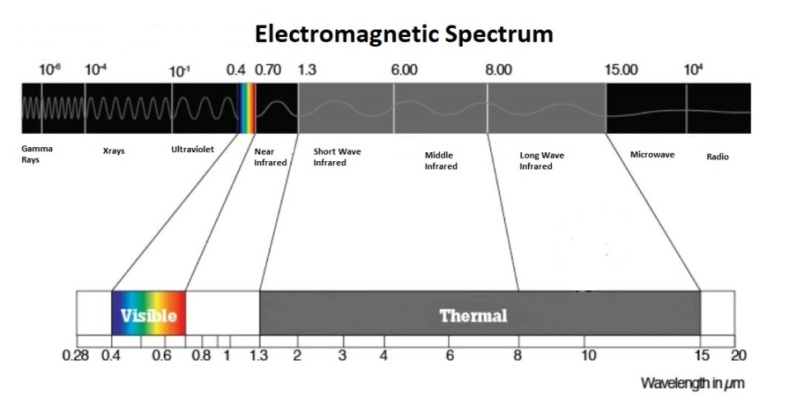
More wavelengths to see
https://www.dronezon.com/learn-about-drones-quadcopters/9-heat-vision-cameras-for-drones-and-how-thermal-imaging-works/

Slide 4
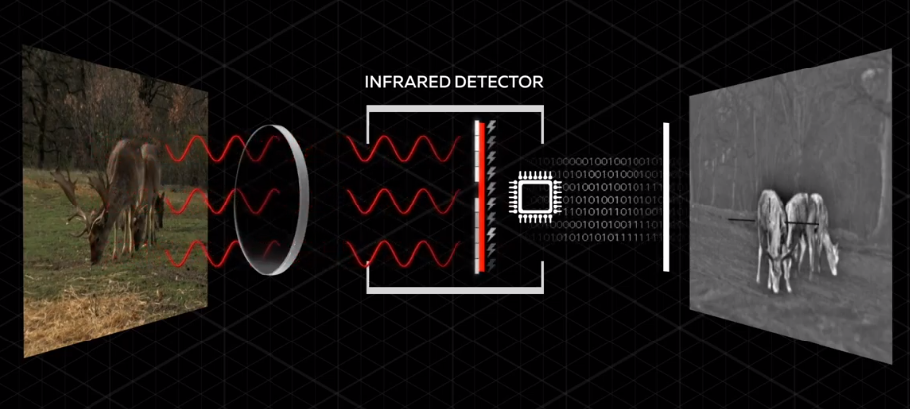
More wavelengths to see
https://youtu.be/Re_DtZrsXbs

Slide 5
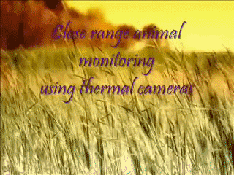
Background

Slide 6


Slide 7
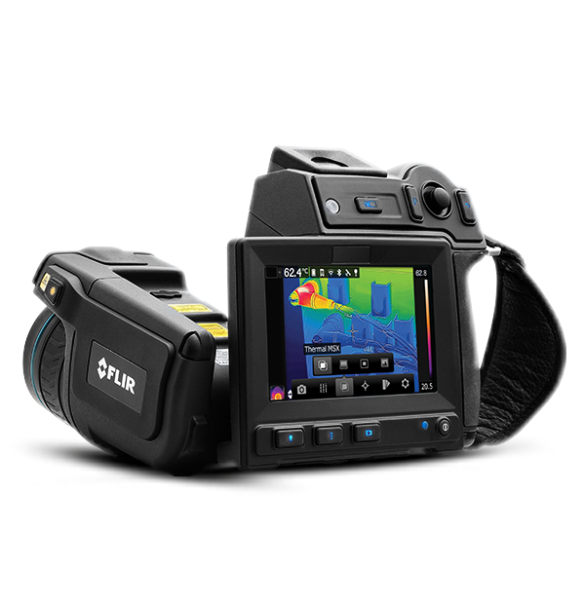
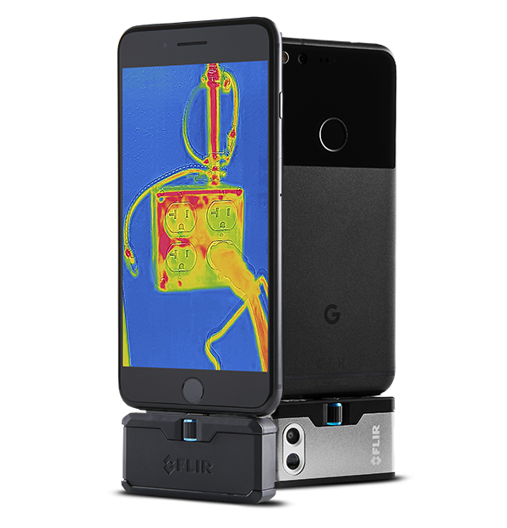
Story

Slide 8
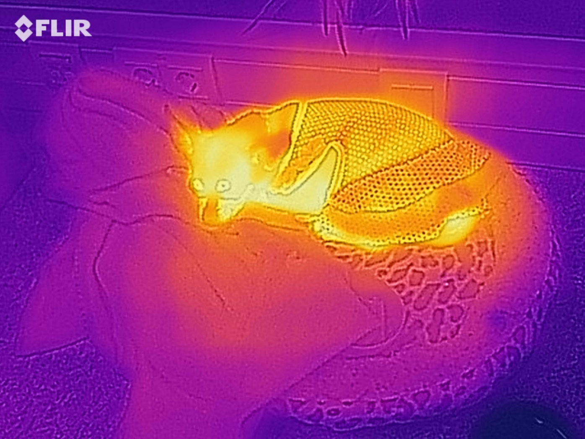
Story

Slide 9
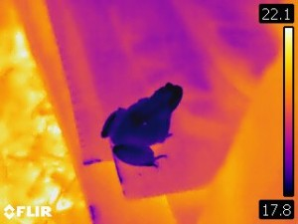
Story

Slide 10

Story

Slide 11
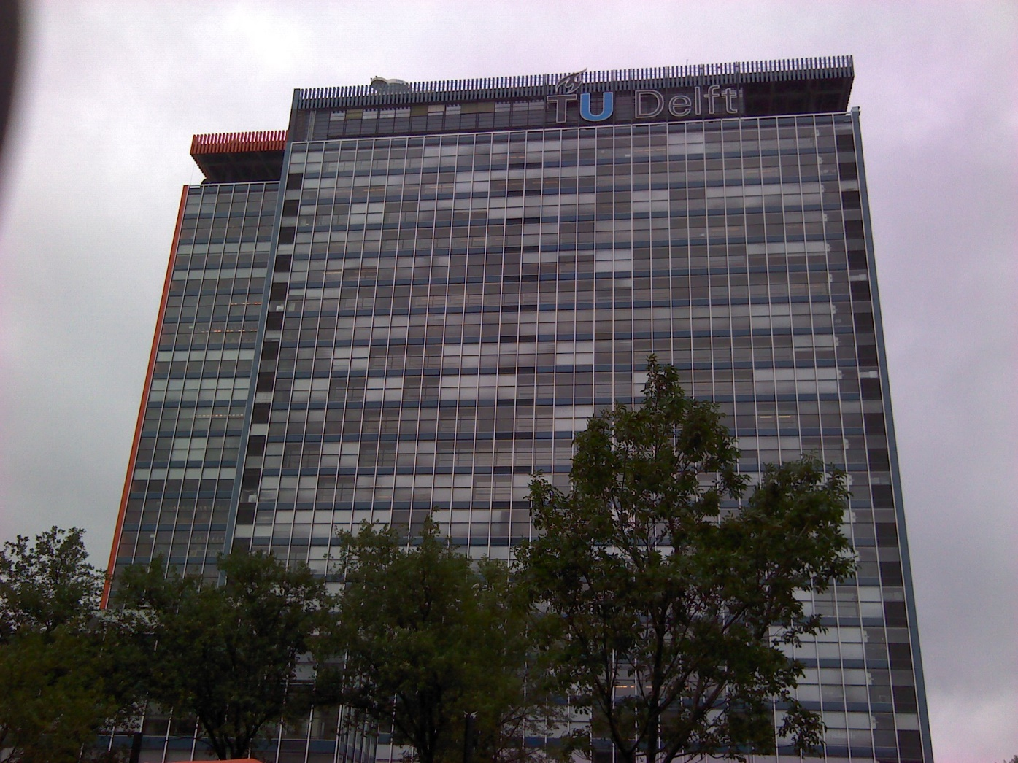
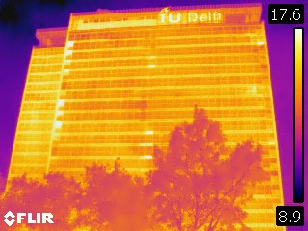
Story

Slide 12
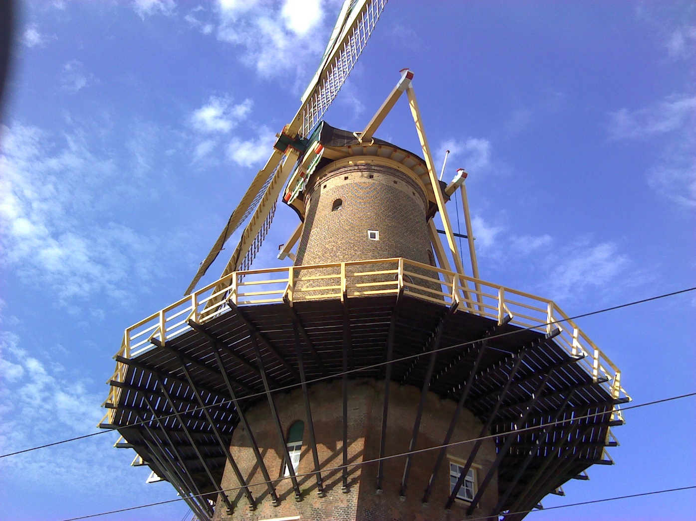
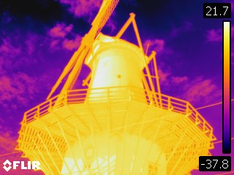
Story

Slide 13


Slide 14


Slide 15

Hi there! I have a camera which shows heat leakages of your house. Do you suspect that you have heat leakage or a wall crack?
I’d be happy to come over there to make some pictures.
Free of course.

Slide 16
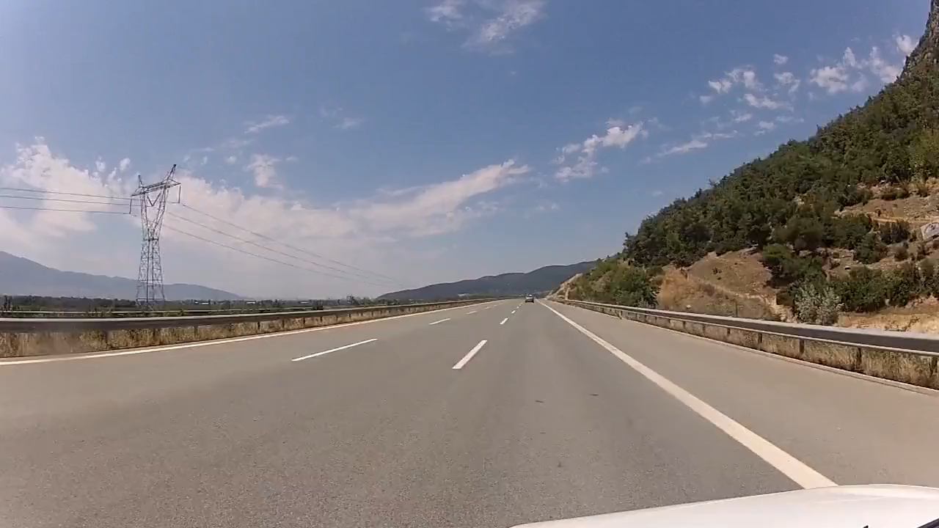

Slide 17
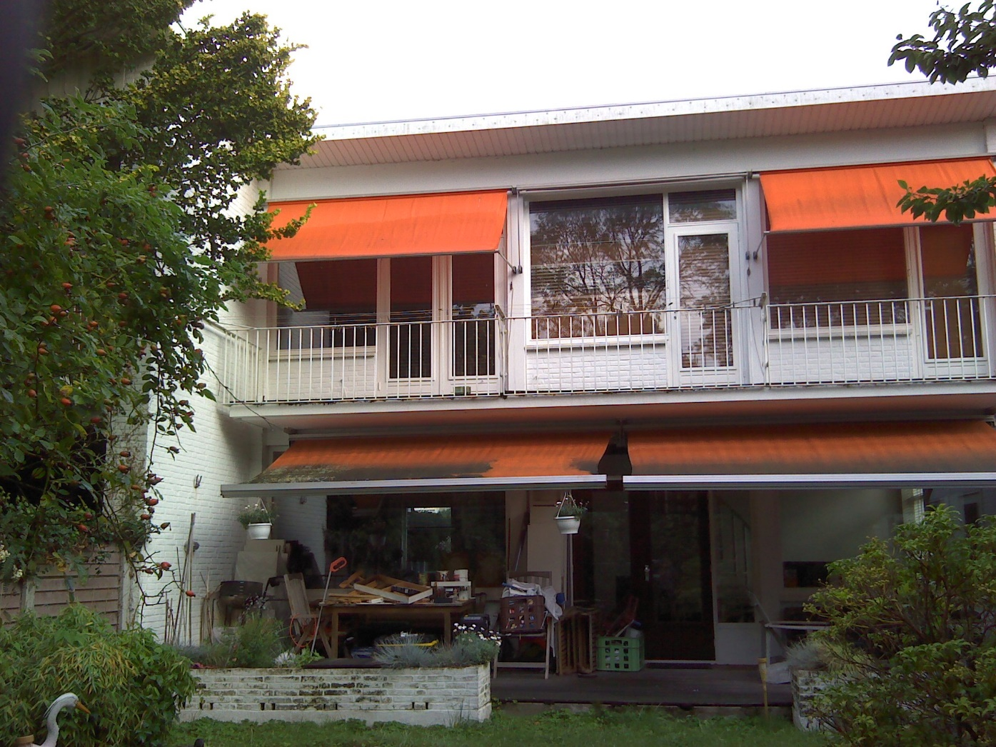
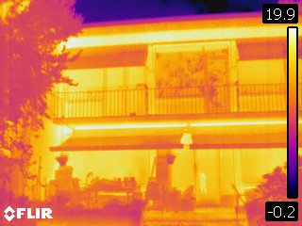
Story

Slide 18
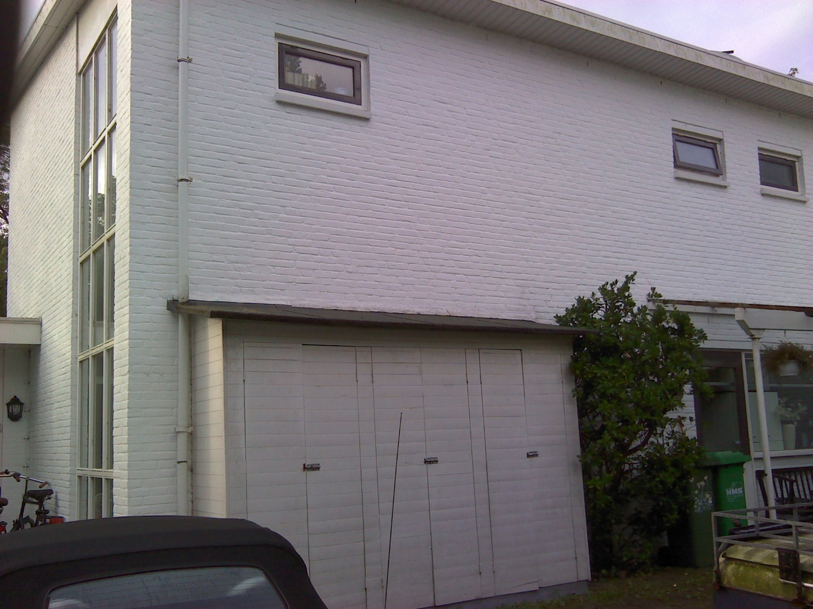
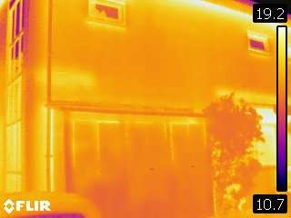
Story

Slide 19
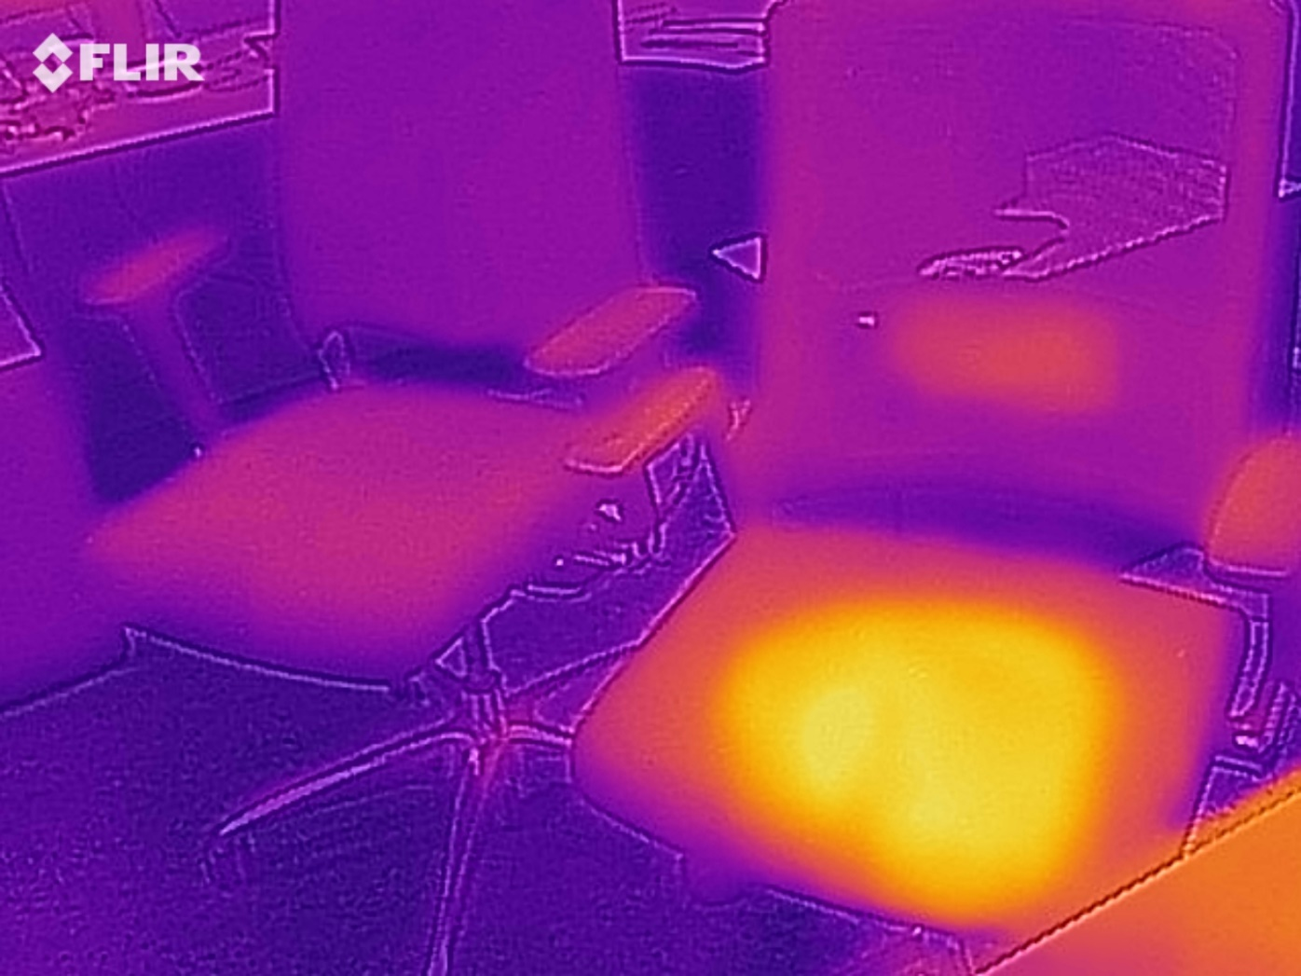
Other applications

Slide 20
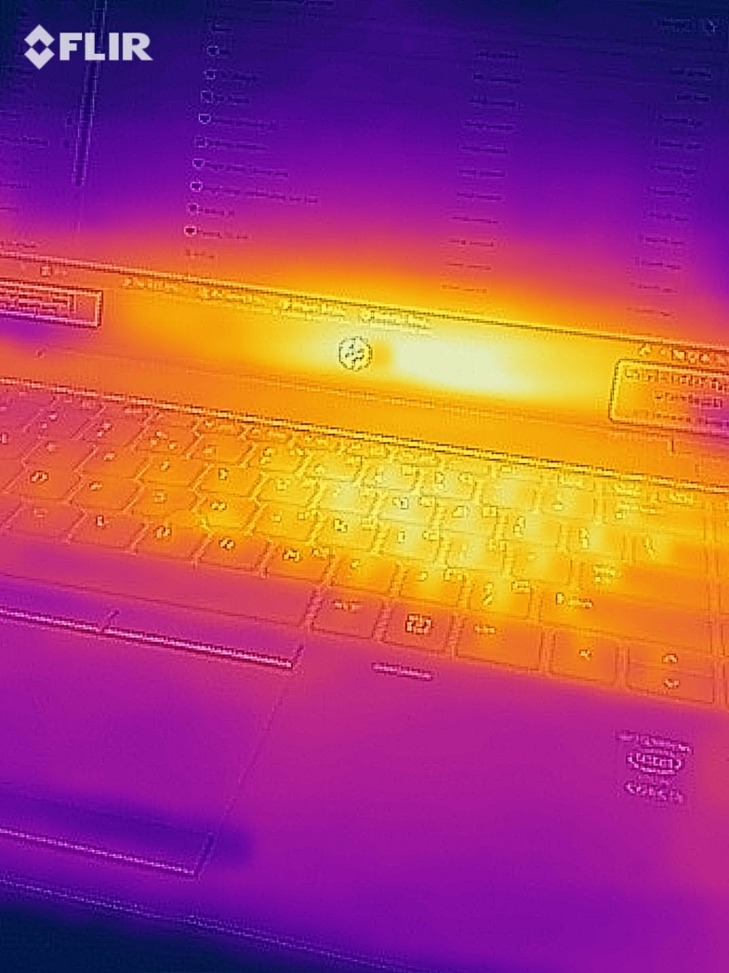
Other applications

Slide 21
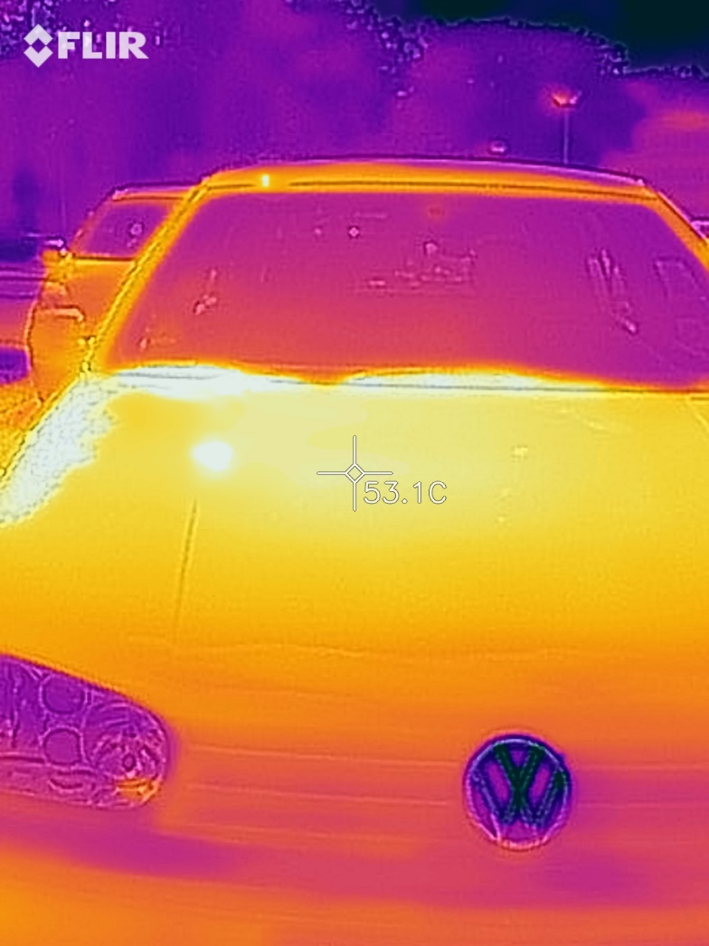
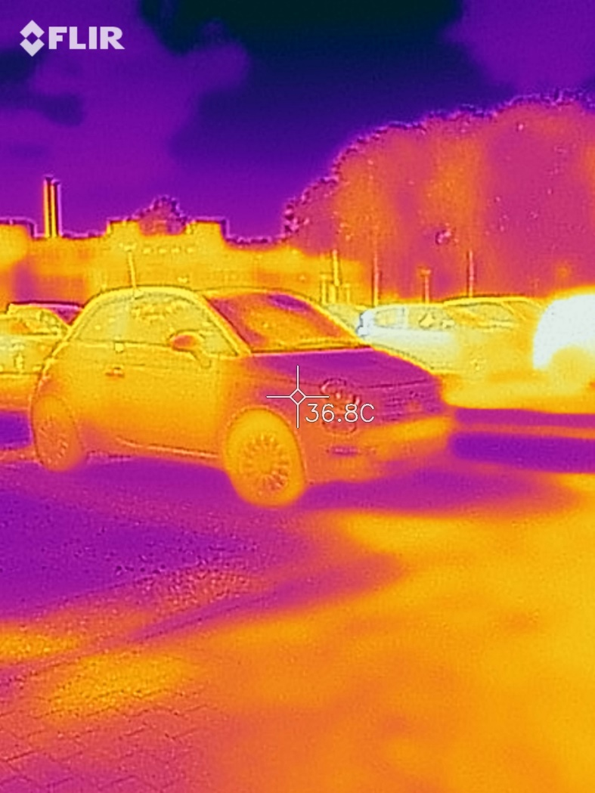
Other applications

Slide 22
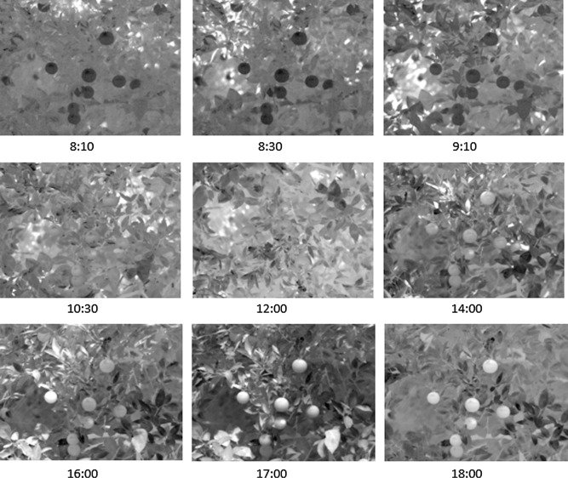
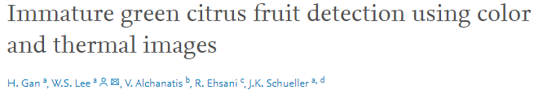
Other applications: harvesting

Slide 23
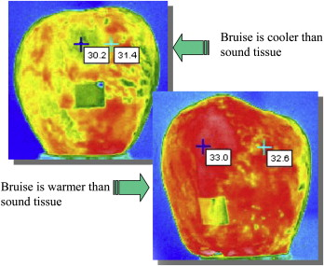
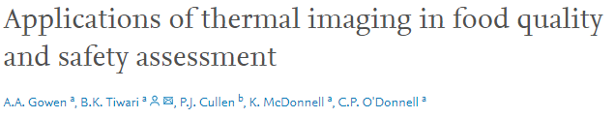
Other applications: post harvest quality

Slide 24

Improving YOLO
Leakage detection
Disease recognition
Product line inspection

